Slide 1
Movie Review Sentiment Analysis
Problem Statement
Online platforms contain thousands of movie reviews, making manual sentiment analysis difficult and time-consuming.
Objective
Build an NLP-based Machine Learning system to automatically classify movie reviews as:
Positive 😊
Negative 😠
Dataset
IMDB 50K Movie Reviews Dataset
50,000 reviews with sentiment labels

Slide 2
Technologies & NLP Workflow
Technologies Used
Python
Pandas
NLTK
Scikit-learn
Streamlit
Matplotlib & Seaborn
Feature Engineering
Bag of Words (BoW)
TF-IDF Vectorization
NLP Preprocessing
Performed:
Lowercase conversion
HTML & URL removal
Emoji & punctuation removal
Tokenization
Stopwords removal
Lemmatization

Slide 3
EDA & Model Training
Exploratory Data Analysis
Sentiment distribution analysis
Word frequency analysis
Positive & Negative WordCloud
Bigram analysis
Review length analysis
Machine Learning Models Used
Model | Accuracy
Logistic Regression | 90.30%
Naive Bayes | 85.04%
Random Forest | 83.81%

Slide 4
Best Model & Deployment
Best Performing Model
Logistic Regression
Accuracy: 90.30%
Fast and efficient for NLP classification
Streamlit Deployment
Developed a web application where users can:
Enter movie reviews
Predict sentiment in real-time
View confidence score percentage
Example Output
😊 Positive Review
Confidence Score: 96.42%

Slide 5
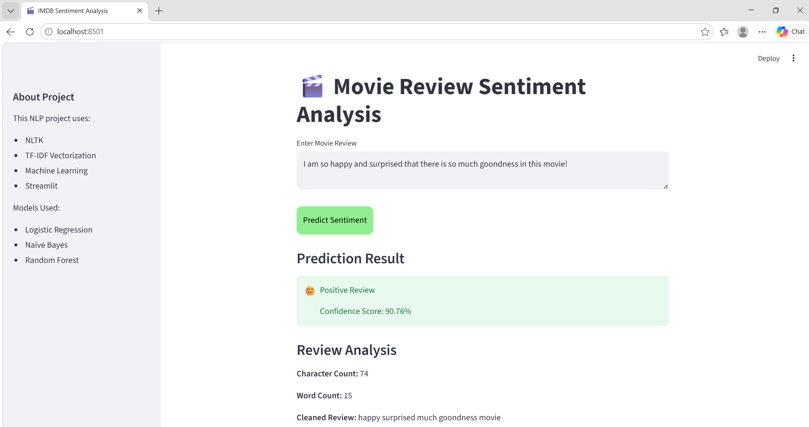

Slide 6
Conclusion & Key Outcomes
Conclusion
Successfully developed an end-to-end NLP Sentiment Analysis system using Machine Learning and Streamlit deployment.
Key Outcomes
Complete NLP preprocessing pipeline
Multiple ML model comparison
Real-time sentiment prediction
Interactive web application

